Slide 1
Kaggle Competition
https://kaggle.com/c/sysu-dmml-a/

Slide 2
Kaggle Competition
Dataset: Quality of Water
Predict the value of “Quality”
Techniques (prediction models) are not restricted to what you have learned so far in this course
You can use other models you have learned
You can use different packages for these techniques
You can search online for tips or tricks that make your coding more efficient
You can use any visualization techniques (no restriction) to help identify patterns and generate ideas to formulate your models

Slide 3
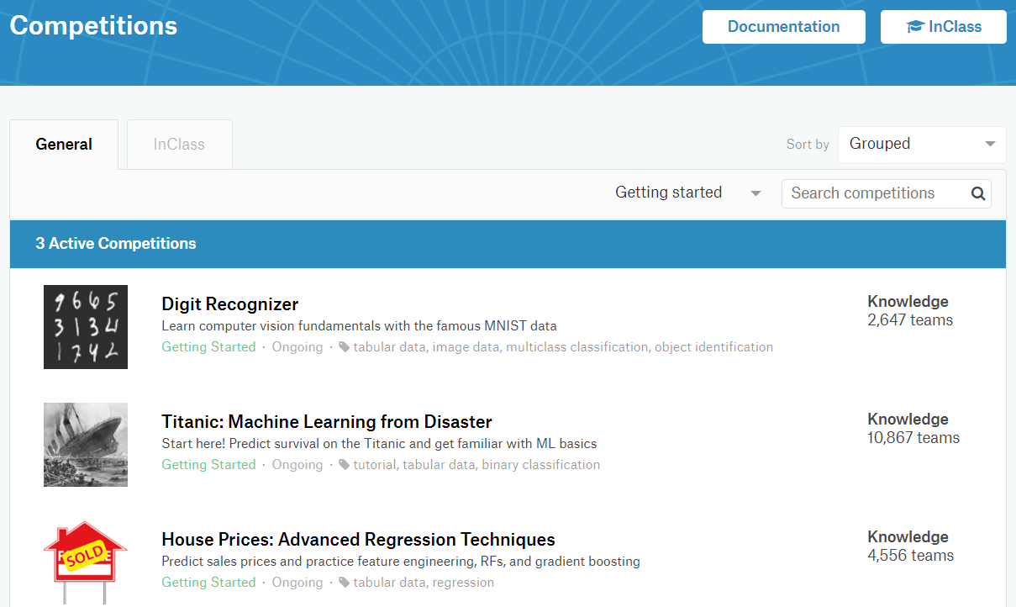
“Getting Started” with Kaggle
Notes:
https://www.kaggle.com/competitions?sortBy=grouped&group=general&page=1&pageSize=20&category=gettingStarted

Slide 4
Grading
5% on model (novelty/rigor) + 10% on prediction performance by the end of the class
Evaluated based on a private test set

Slide 5
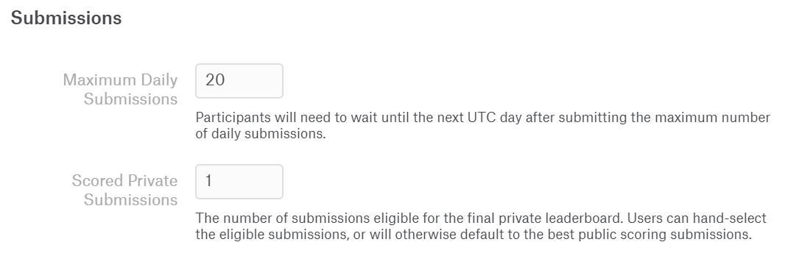
Rules
Each student is allowed to have only one account
Team name format: “StudentName_StudentID”, “StudentName_StudentID”
Submission under different names will not be considered
Each student can submit maximum 20 attempts every day

Slide 6
Submission
Predictions submitted to Kaggle
Raw code in a single Notebook file with description on your approach
One file per student
Be able to compile with training and test data stored in the same location
Submit to TA

